Slide 1

HTML/CSS
Week 1
Majd Darraj
Krishna Rana

Slide 2
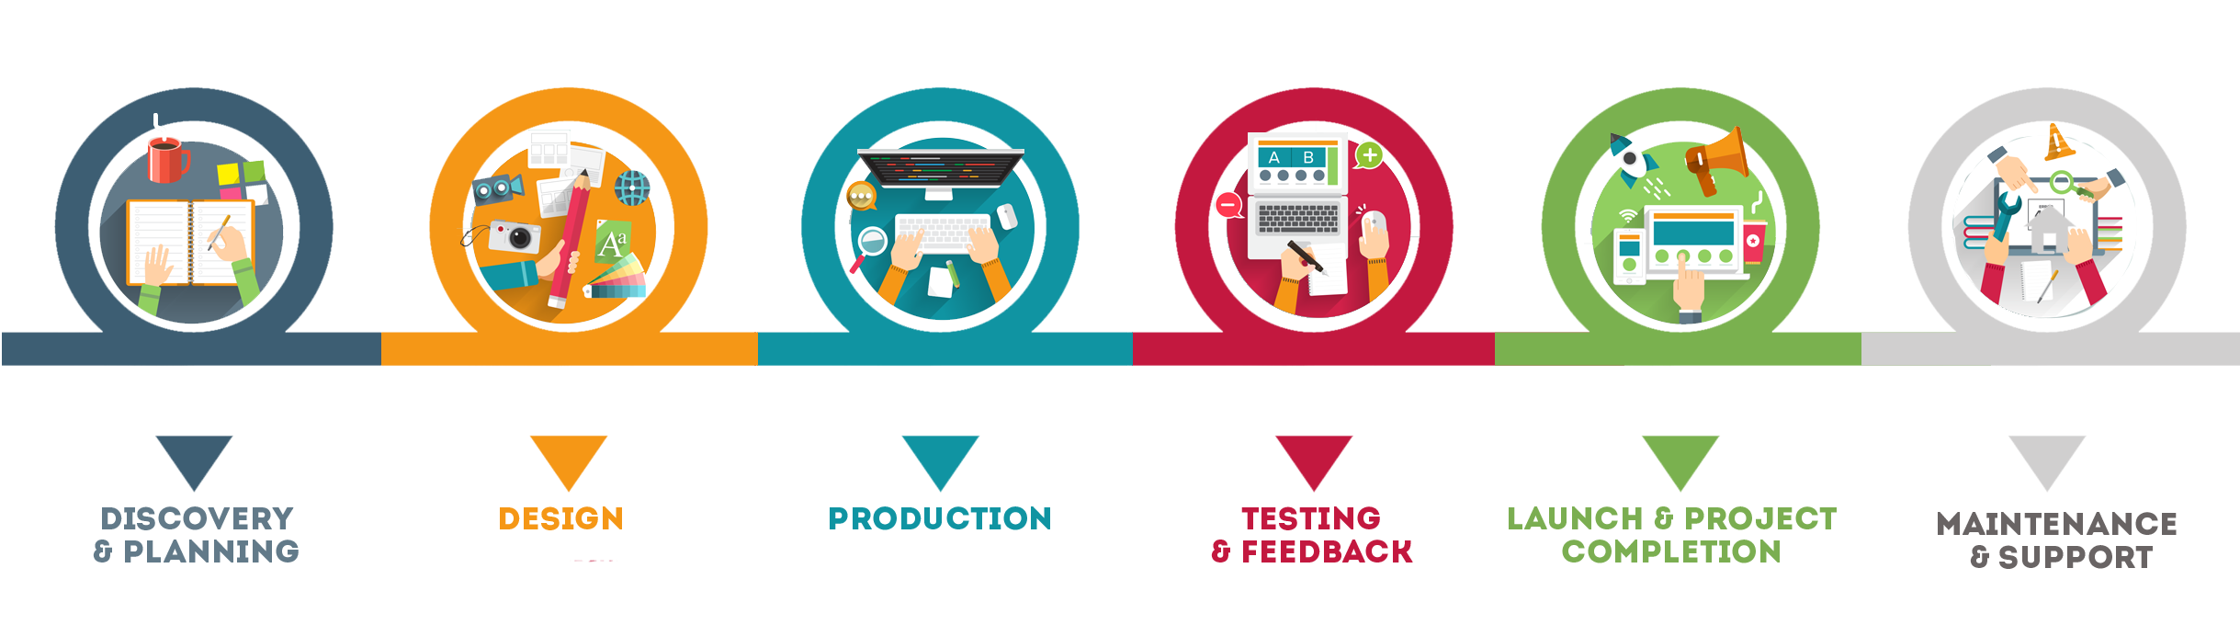
Digital Product
Development Process

Slide 3
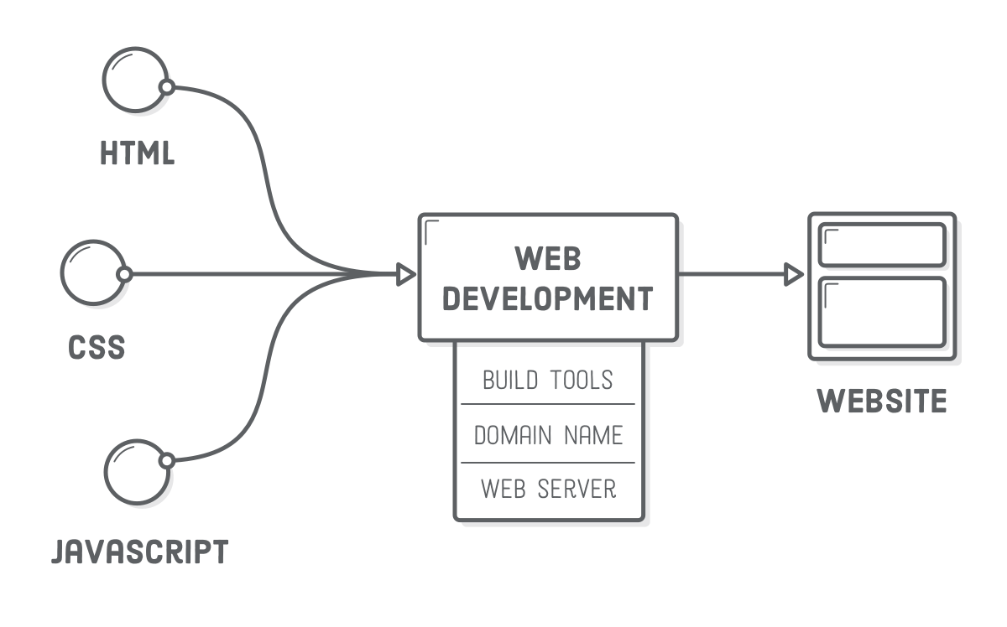
Web Development
Elements

Slide 4
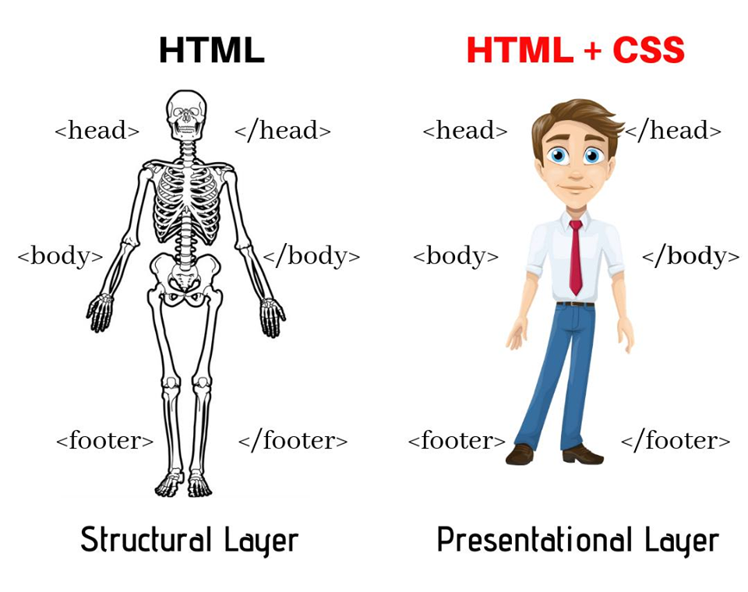
HTML vs. CSS

Slide 5
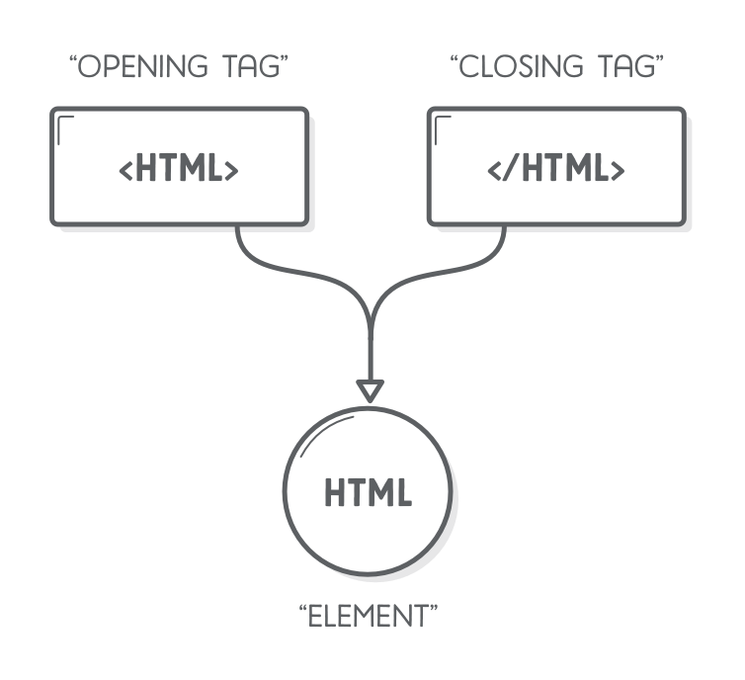
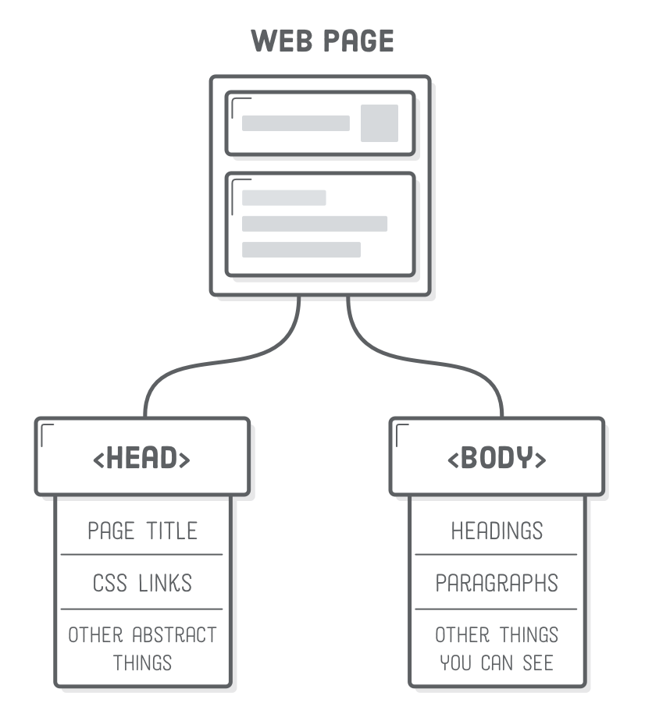
Web page structure

Slide 6
Essential HTML elements

Slide 7
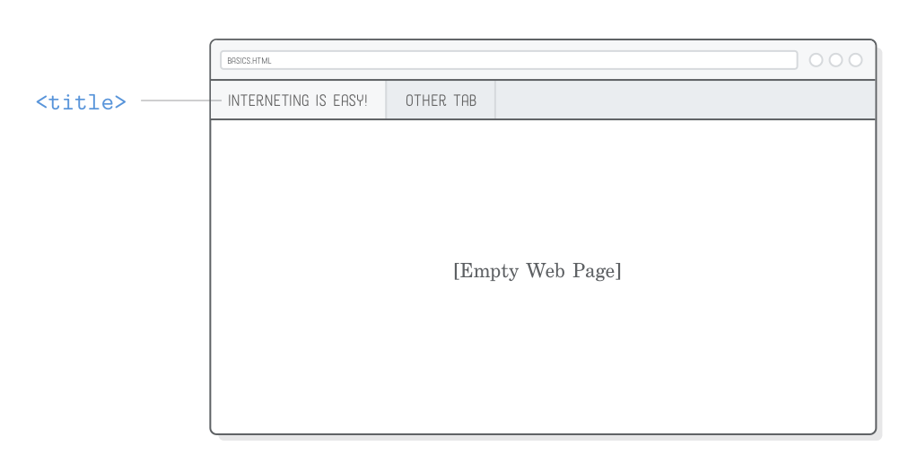
Head: <title>

Slide 8
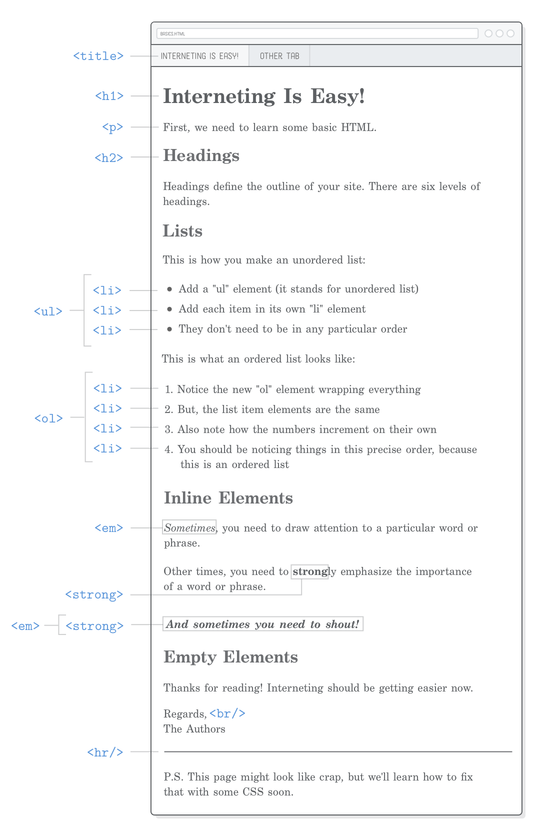
HTML elements

Slide 10
<img> tag

Slide 11
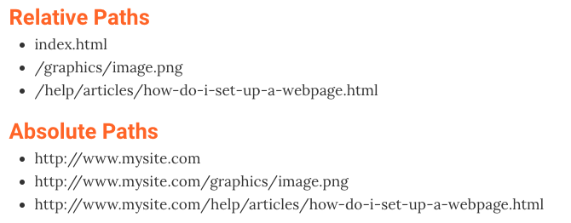
Relative vs Absolute Paths

Slide 12

Document
Object
Model
Describe relationships in HTML
Browsers reads and organize HTML as a DOM
* Every element is a Node in the DOM

Slide 13
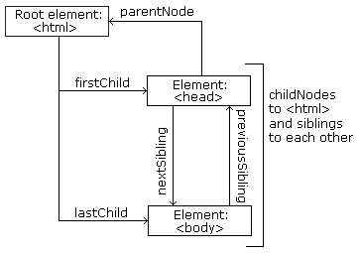
Each HTML element (node) has different relationships
Parent
<html> is the parent of <head> and <body>
<head> is the first child of <html>
<body> is the last child of <html>
Child
Sibling

Slide 14
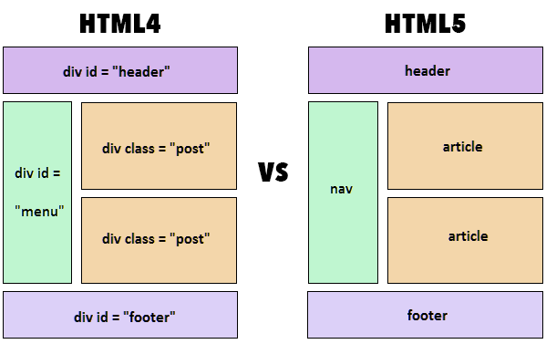
4 vs. 5

Slide 15
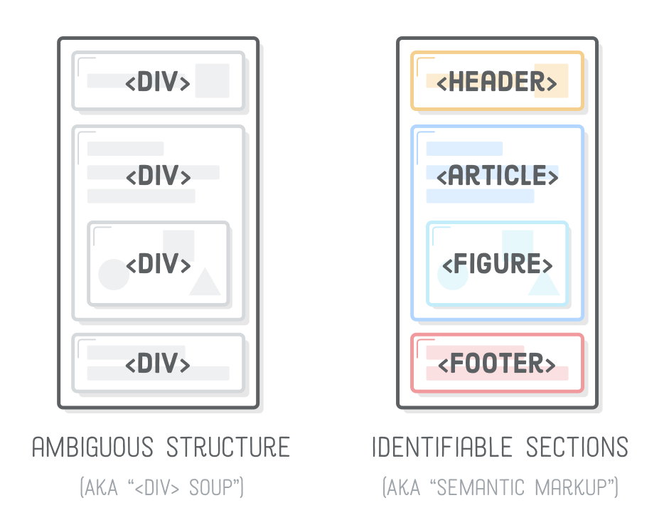
HTML Semantic Elements (HTML5)
For search engines
Semantic tags helps them quickly identify the structure of your entire website, making it easier to discover other pages.

Slide 16
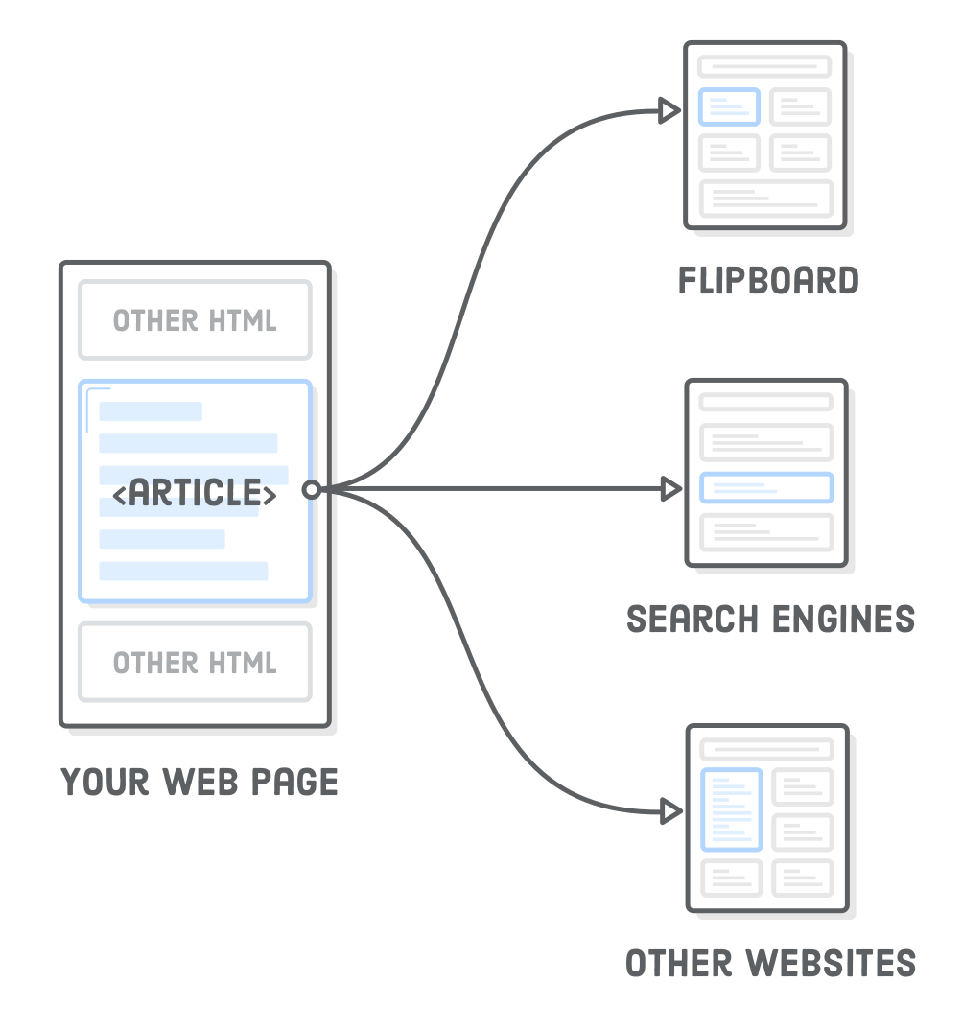
<article>
The <article> element represents an independent article in a web page
article CAN be taken out of the page and keep it’s context
used in blog posts, newspaper articles, or web pages dedicated to a single topic

Slide 17
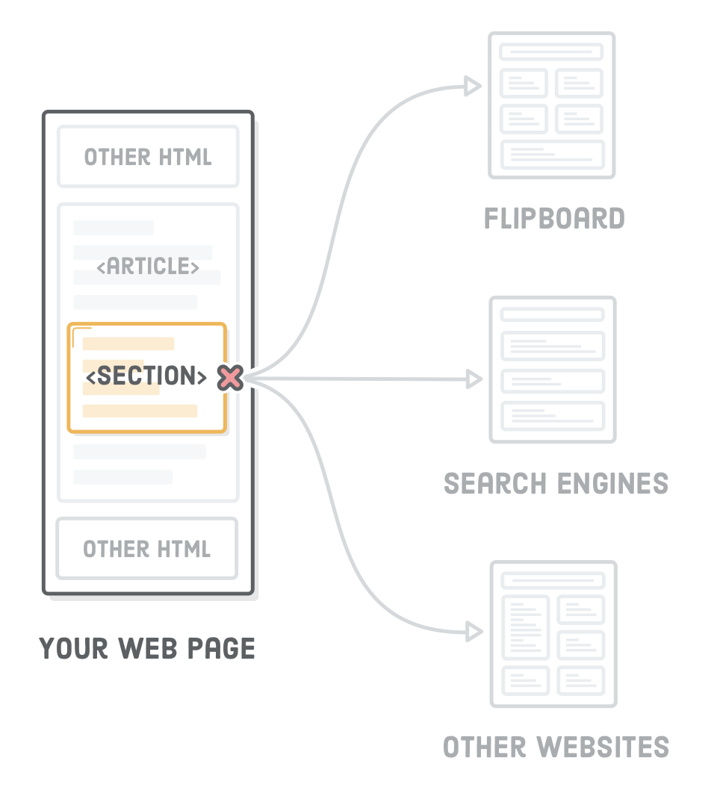
<section>
Like article it wraps a context but it doesn’t need to make sense outside the context of the page
<section> is more descriptive <section>element over a generic <div>
Each section should have at least one heading <h1> to <h6> elements
use <section> only as a replacement for container <div>’s when appropriate.

Slide 18
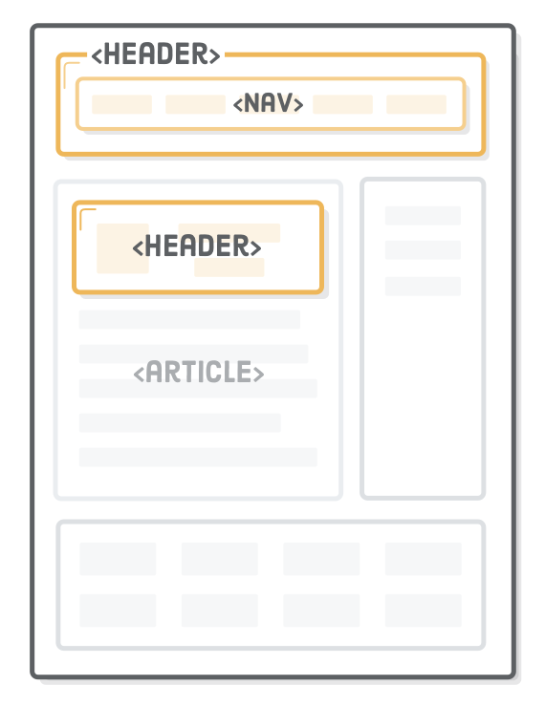
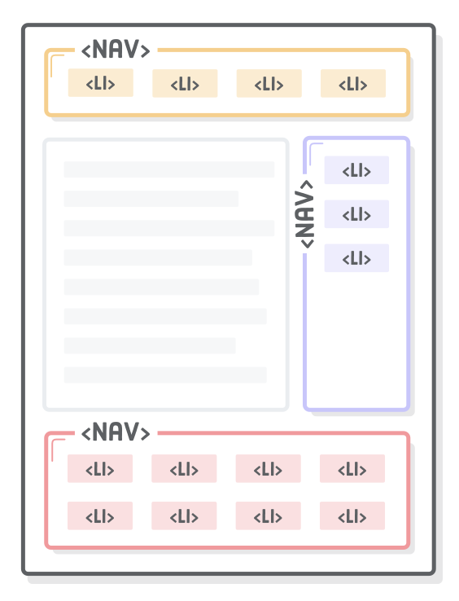
It denotes introductory content for a section, article, or entire web page
mark up the various navigation sections of your website

Slide 19
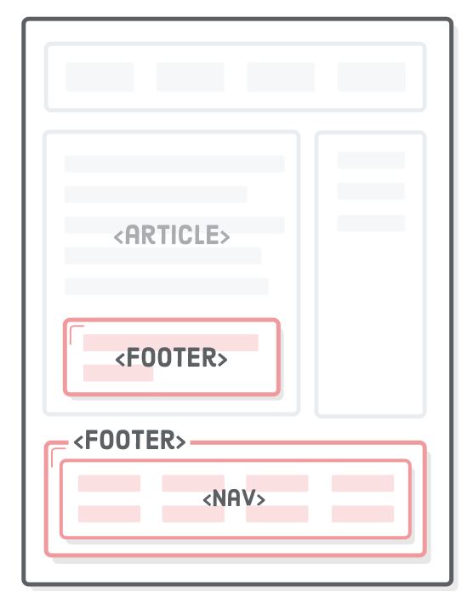
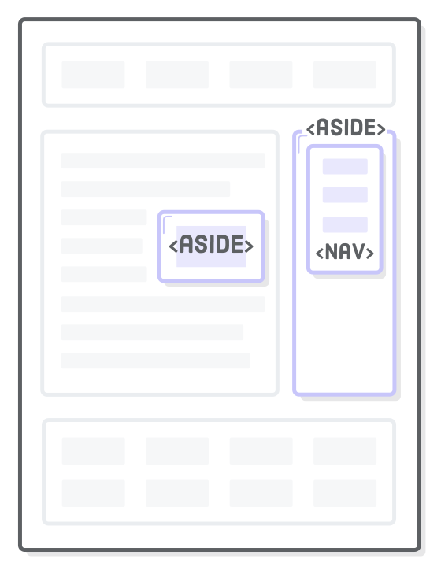
copyright notices, footer navigation, and author bios at the end of blog posts
sponsored blog post might contain an advertisement about the sponsoring company

Slide 20
CSS

Slide 21
CSS Link

Slide 22
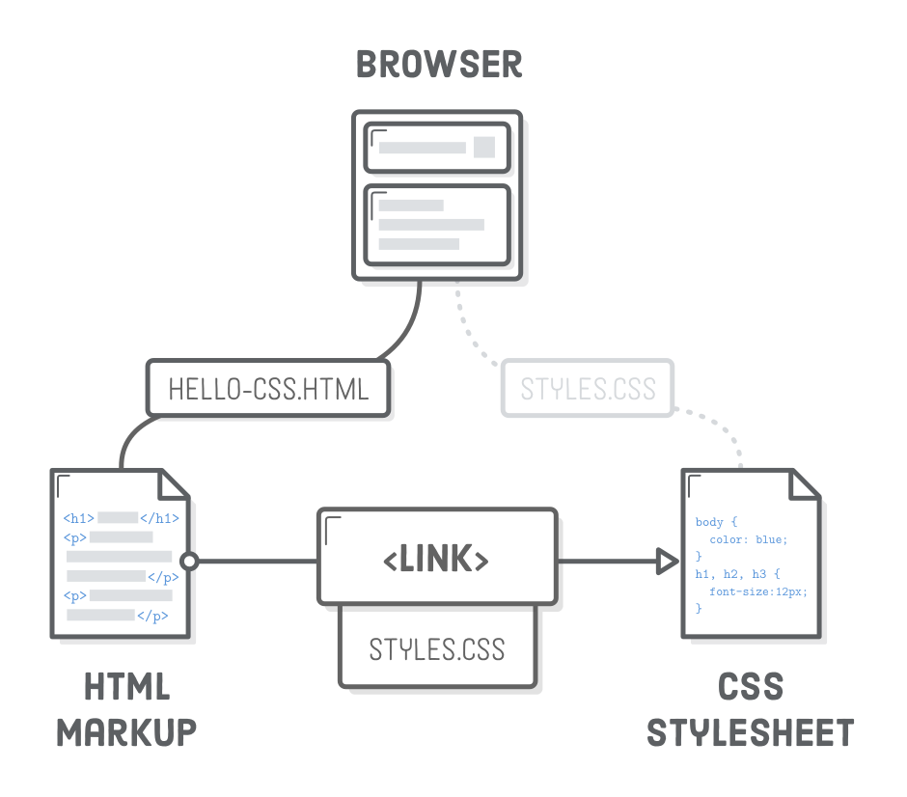
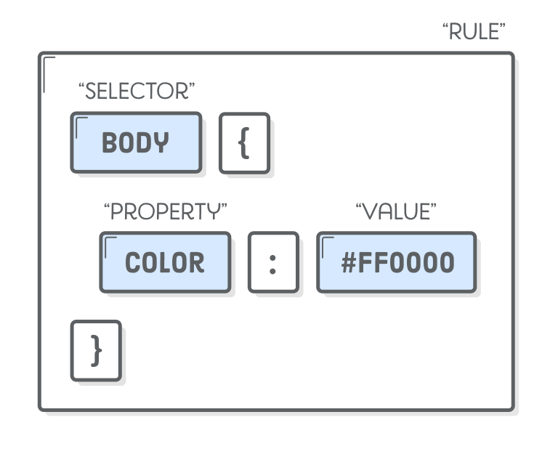
CSS Selectors

Slide 23
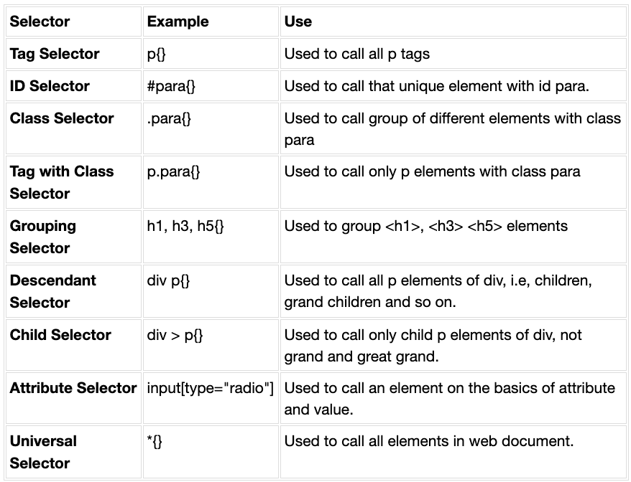
CSS selectors
https://tutorial.techaltum.com/cssselectors.html

Slide 24
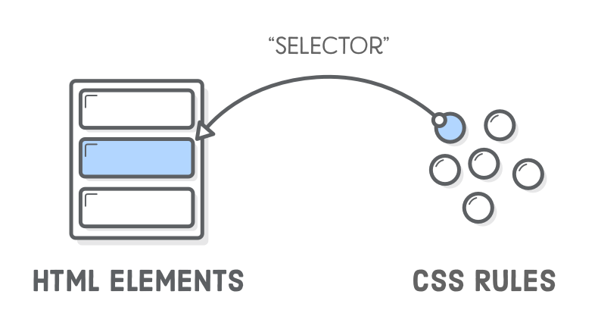
CSS selectors

Slide 25
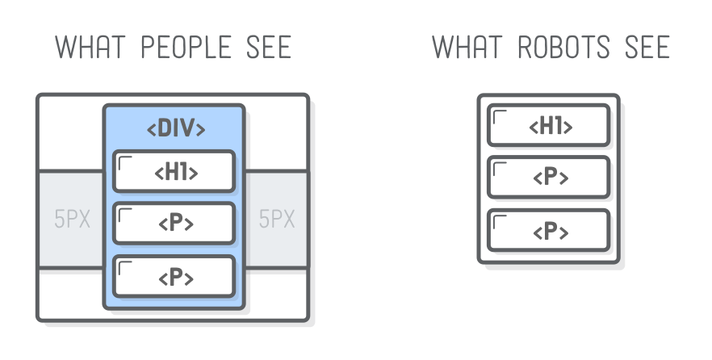
Use <div>s for styling and structuring
<div class=“container”>
<h1>title</h1>
<p>text</p>
<p>text</p>
</div>

Slide 26
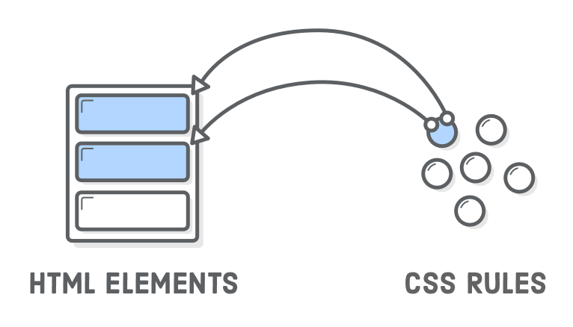
CSS rules are Reusable
for multiple elements
<div class='button'>Button One</div>
<div class='button'>Button Two</div>

Slide 27
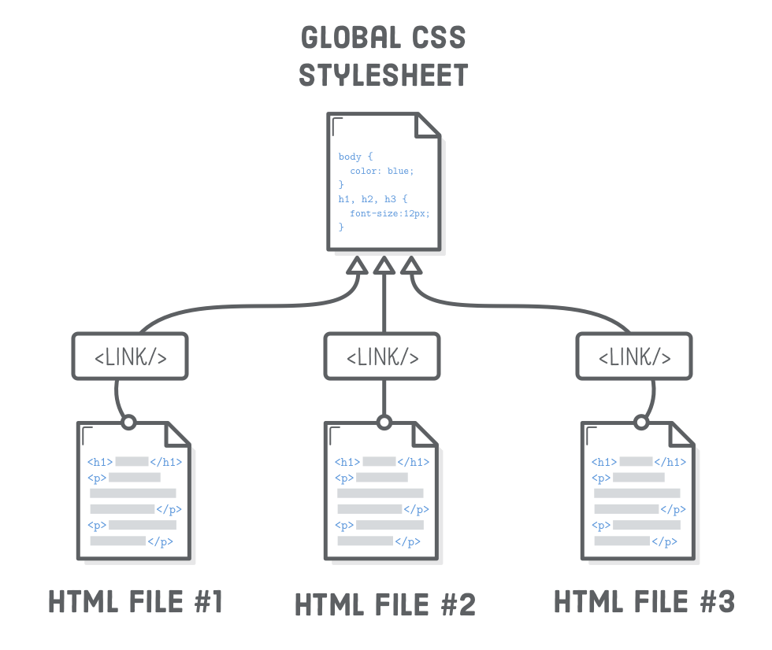
CSS rules are Reusable
for multiple pages (html files)

Slide 28
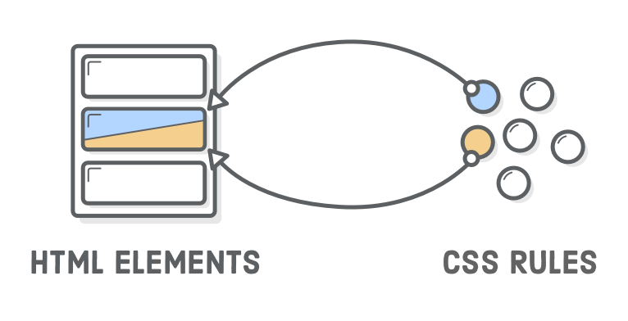
One html element takes
more than one CSS rule
Order doesn’t matter in html / but do in css
<div class='button red'>Button One</div>
<div class=‘red button'>Button Two</div>

Slide 29
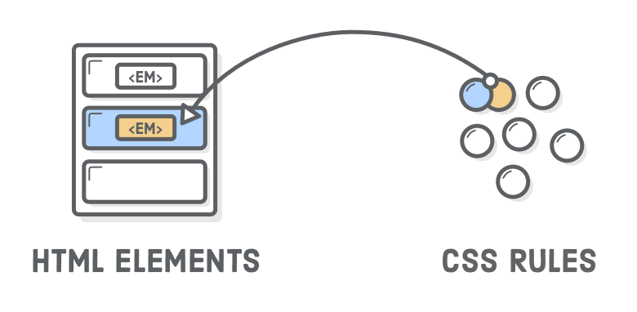
Descendant selectors
<h1> here is <em>text</em> about..</h1>
H1 em {
Font-size: 1em
}

Slide 30
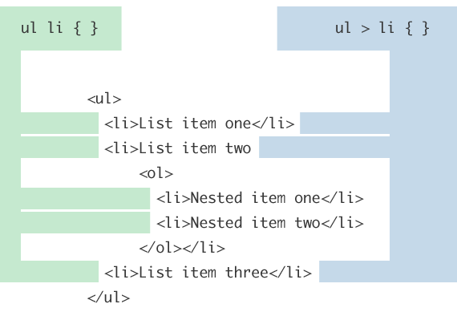
Child Combinator

Slide 31
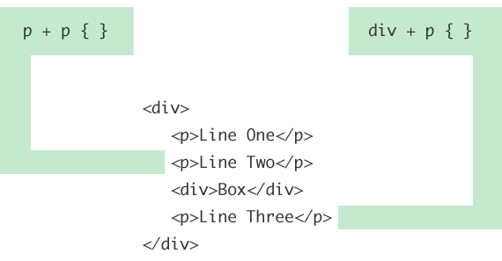
Adjacent Sibling Combinator

Slide 32
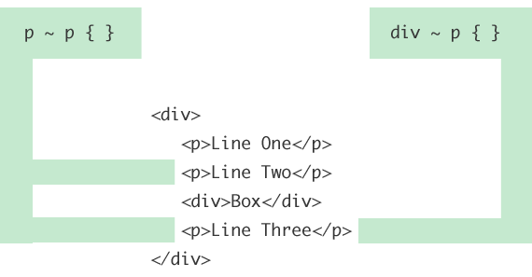
General Sibling Combinator

Slide 33
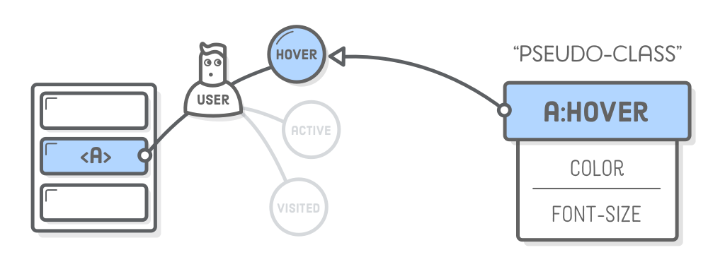
Pseudo-classes for links
:link – A link the user has never visited.
:visited – A link the user has visited before.
:hover – A link with the user’s mouse over it.
:active – A link that’s being pressed down by a mouse (or finger).
a:visited:hover { color: orange; }
a:hover { color: orange; }

Slide 34
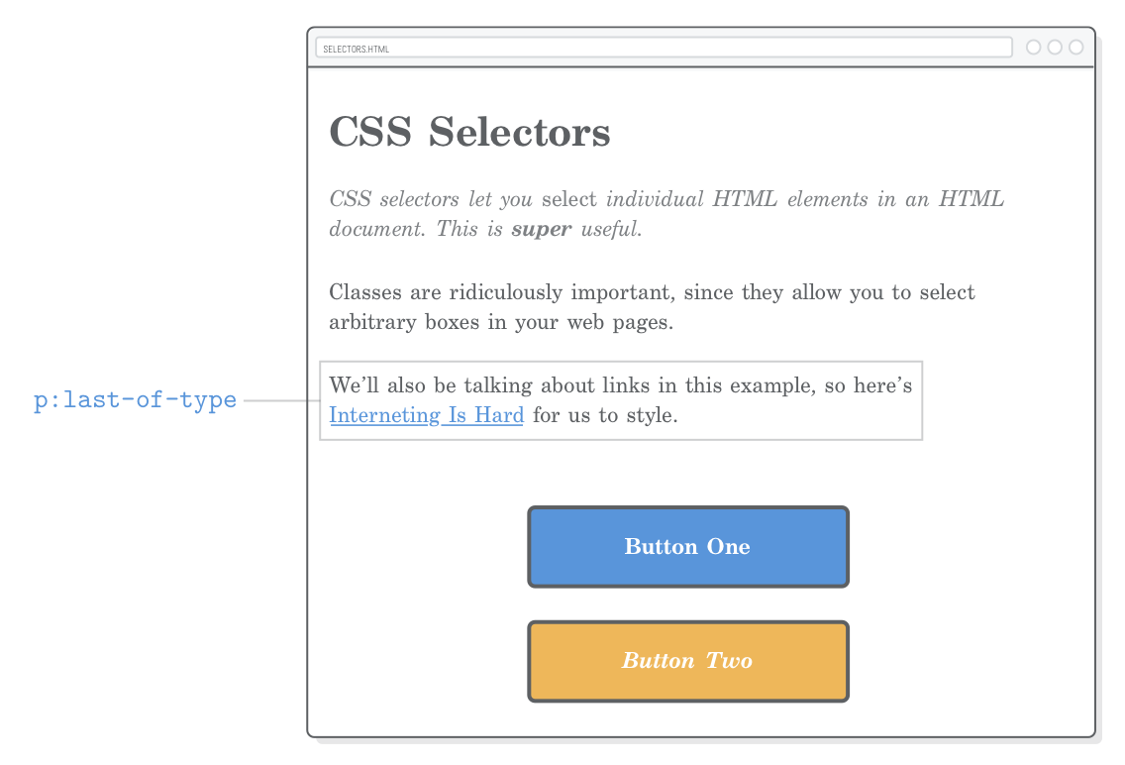
Pseudo-classes for structure
p:last-of-type { margin-bottom: 50px; }
p:first-of-type { color: #7E8184; font-style: italic; }
.page > p:first-of-type {
color: #7E8184;
font-style: italic;
}

Slide 35
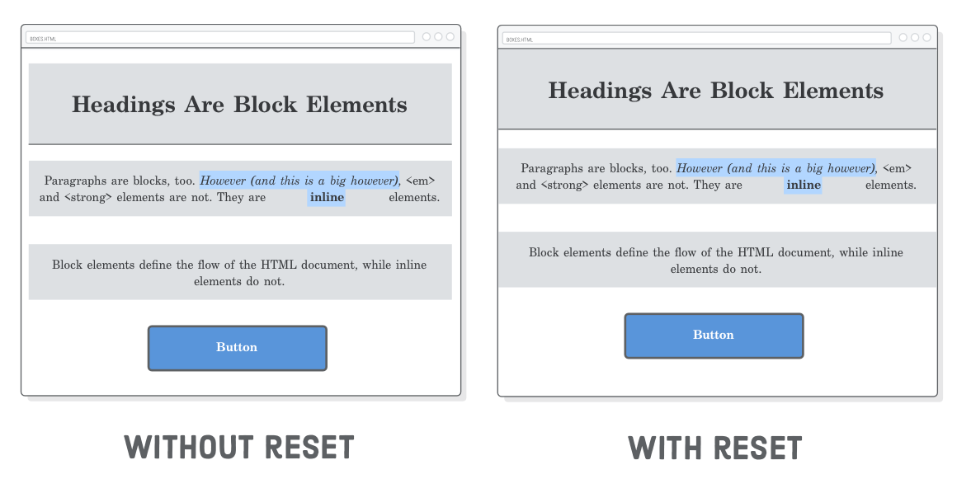
Resetting styles
* { margin: 0;
padding: 0;
box-sizing:
border-box; }

Slide 36
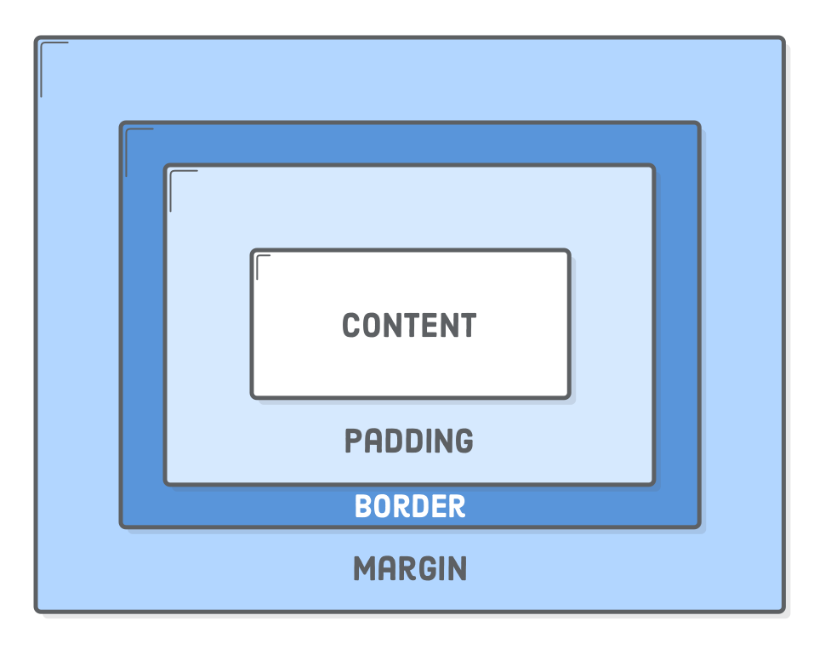
Box Model

Slide 37
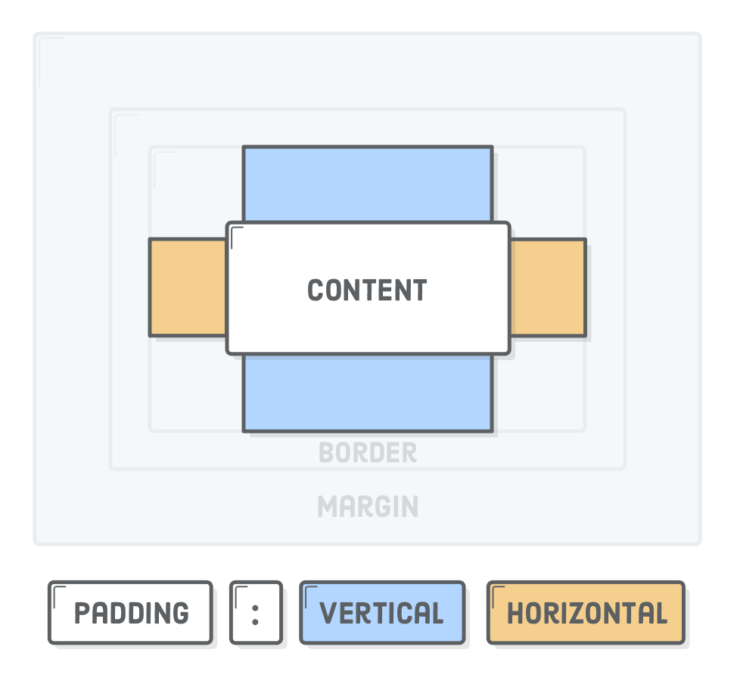
Padding
h1 {padding-top: 20px; }
h1 {padding-bottom: 20px; }
h1 {padding-right: 20px; }
h1 {padding-left: 20px; }
h1 {padding: 20px; }
h1 {padding-left: 20px 10px; }
https://www.w3schools.com/css/css_padding.asp

Slide 38
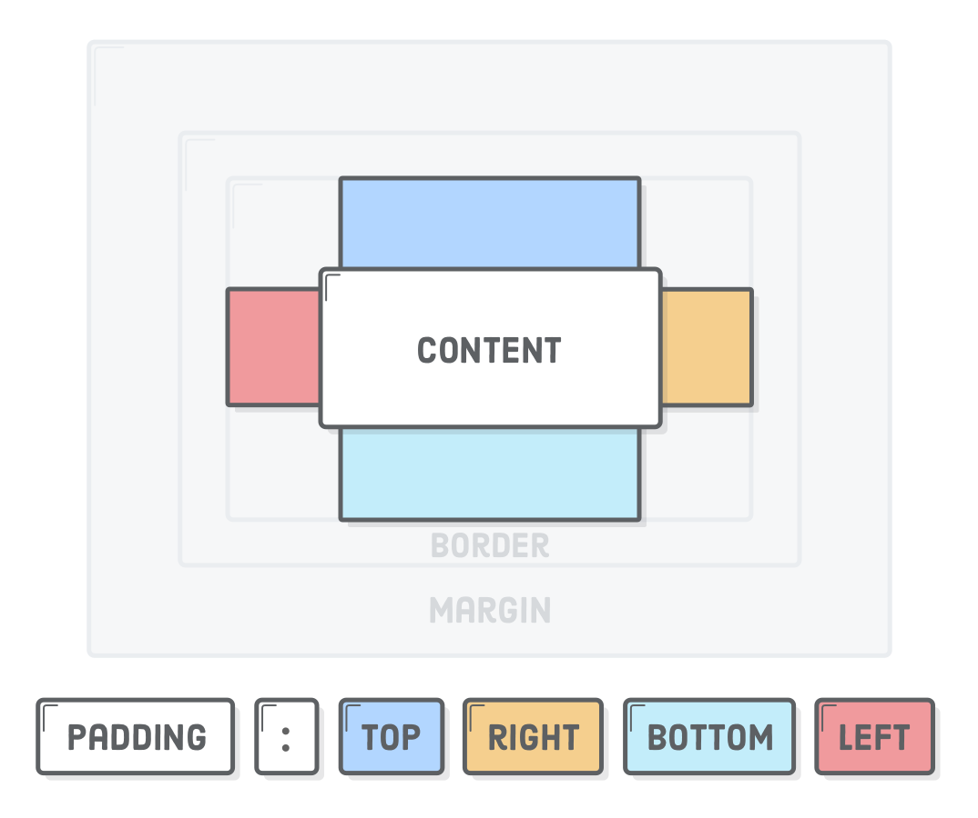
Shorthand
h1 {padding: 10px 20px 0px 5px; }
https://www.w3schools.com/css/css_padding.asp

Slide 39
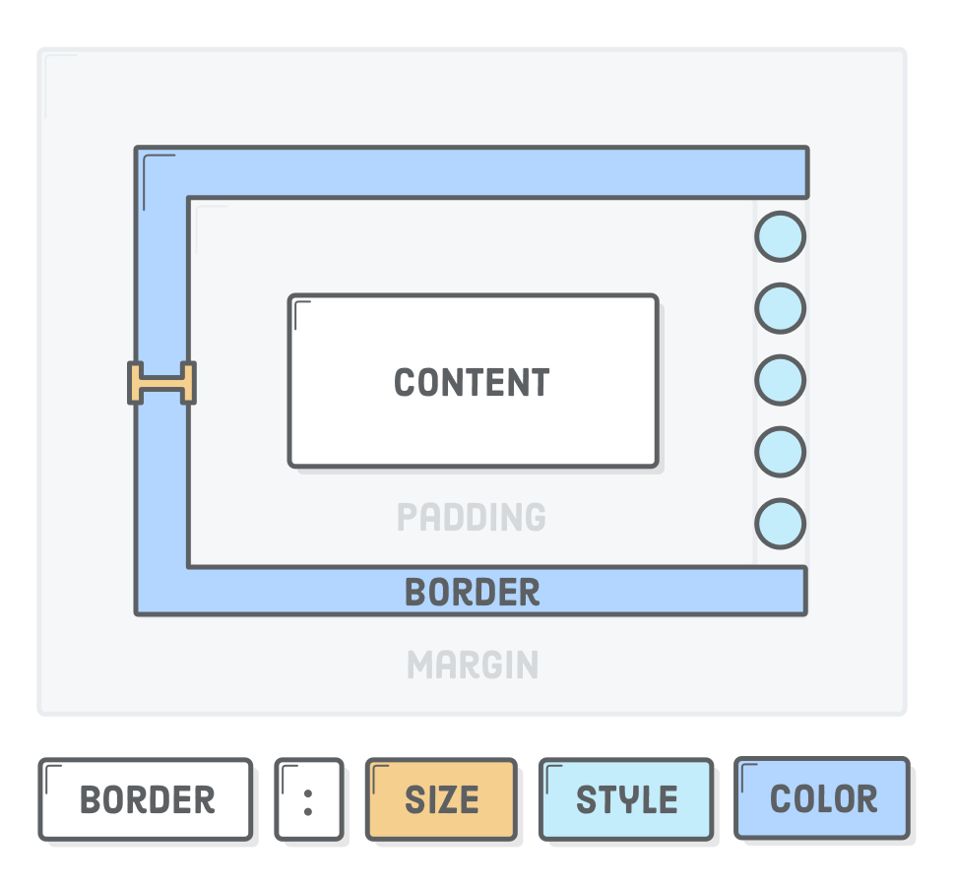
Border
h1 {border-width: 2px; }
h1 {border-style: solid; }
h1 {border-color: blue; }
h1 {border: 2px solid blue; }
h1 {border-radius: 5px; }
h1 {border-bottom-left-radius: 5px; }
h1 {border-bottom-radius: 5px; }
h1 {border-bottom-color: 5px; }
https://www.w3schools.com/css/css_border.asp

Slide 40
Margin
h1 {margin-top: 20px; }
h1 {margin-bottom: 20px; }
h1 {margin: 20px 10px; }
h1 {margin: 20px 10px 0px 5px; }
https://www.w3schools.com/css/css_margin.asp

Slide 41
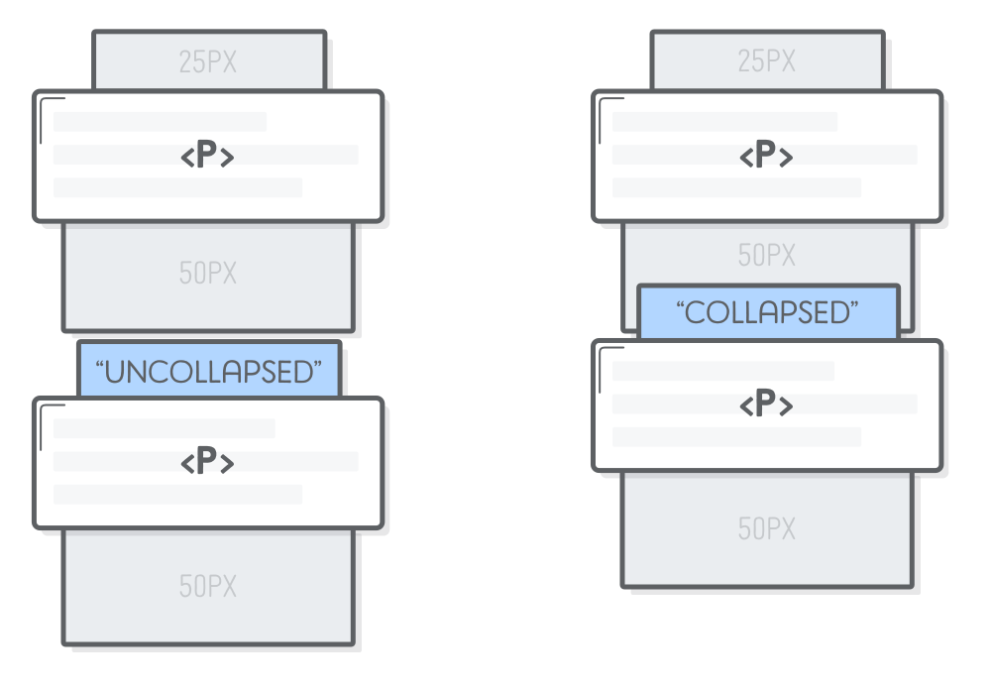
Vertical margin collapse
only the biggest one is displayed

Slide 42
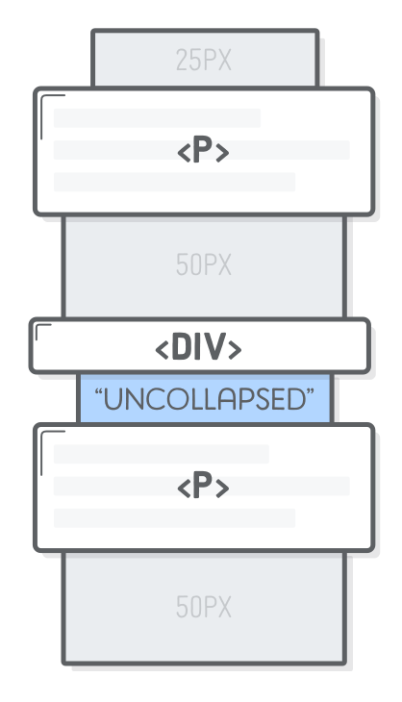
Prevent margin collapse
<p>Paragraph </p>
<div style='padding-top: 1px'></div> <!-- Add this -->
<p> Paragraphs</p>
https://developer.mozilla.org/en-US/docs/Web/CSS/CSS_Box_Model/Mastering_margin_collapsing

Slide 43
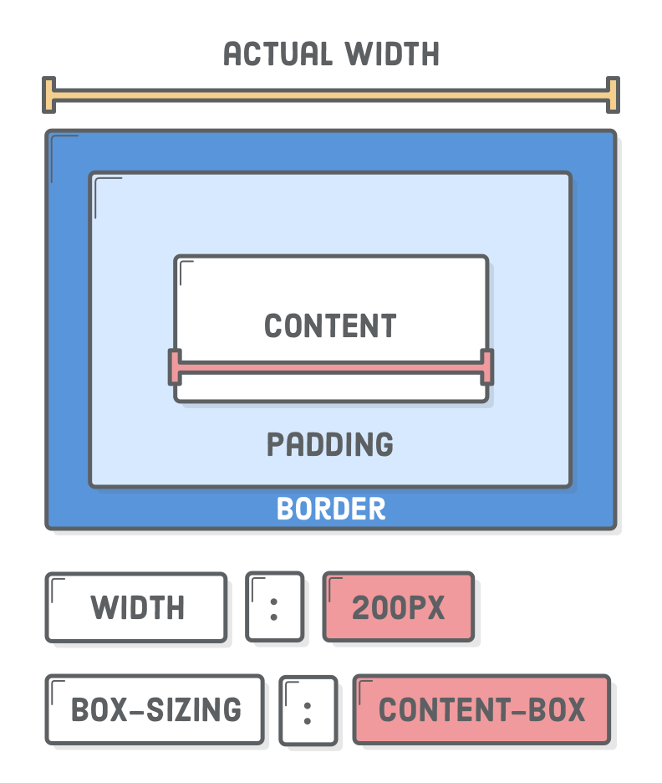
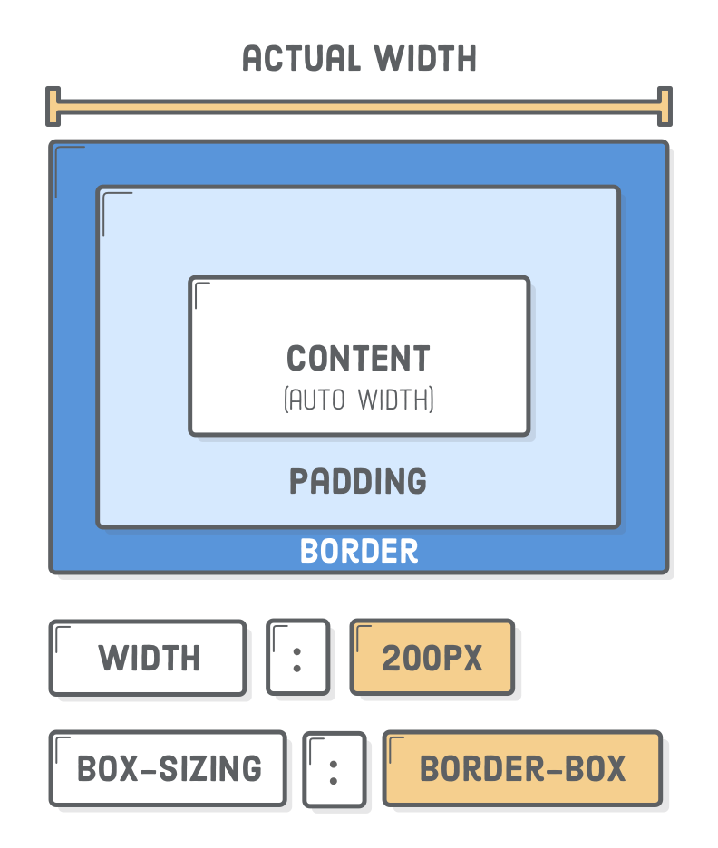
Content Box - Border Box
https://www.w3schools.com/css/css_margin.asp

Slide 44
CSS naming
http://getbem.com/naming/

Slide 45
Thanks!
HackYourFuture

